Slide 1
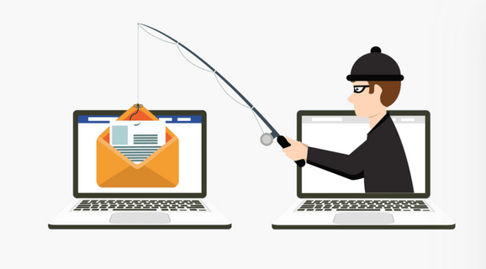
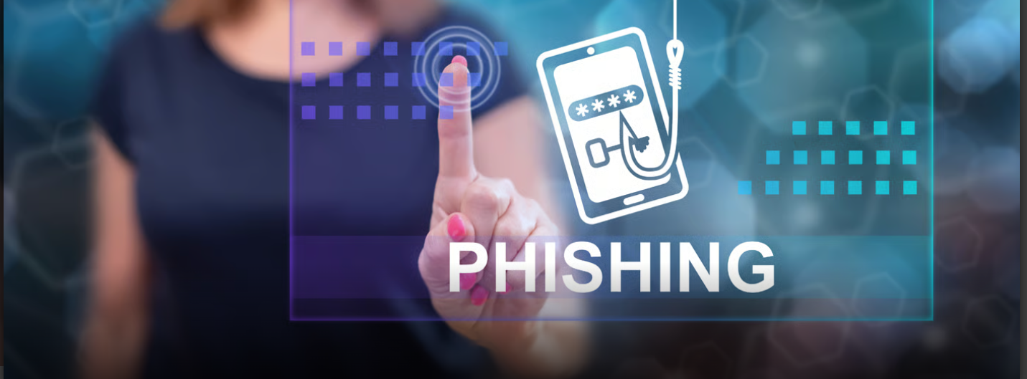
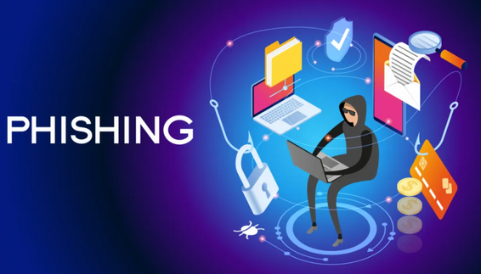
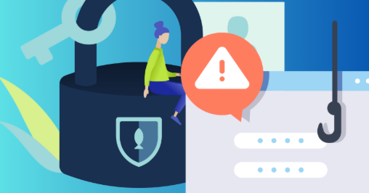

PHISHING AWARENESS TRAINING
Cyber Security Internship Task 2

Slide 2
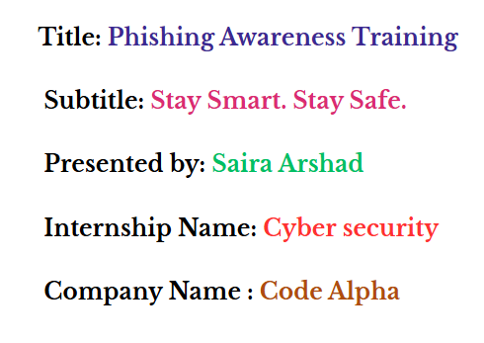

Slide 3
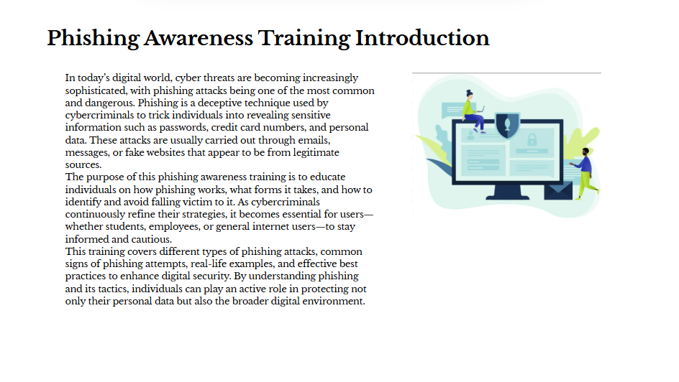

Slide 4
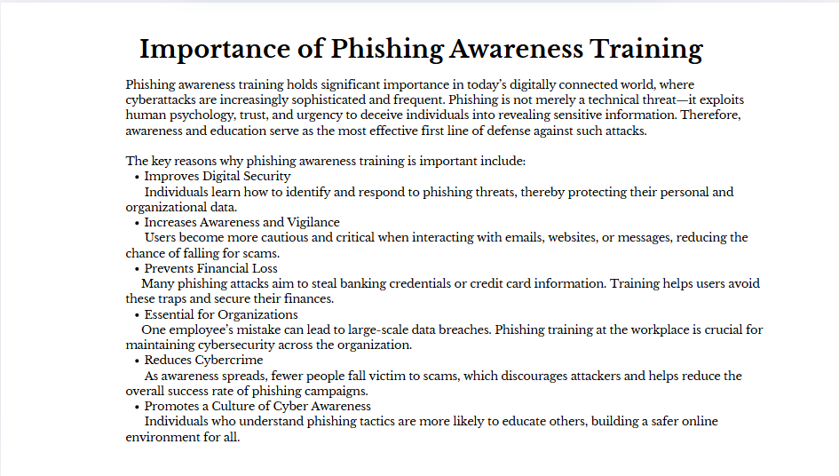

Slide 5
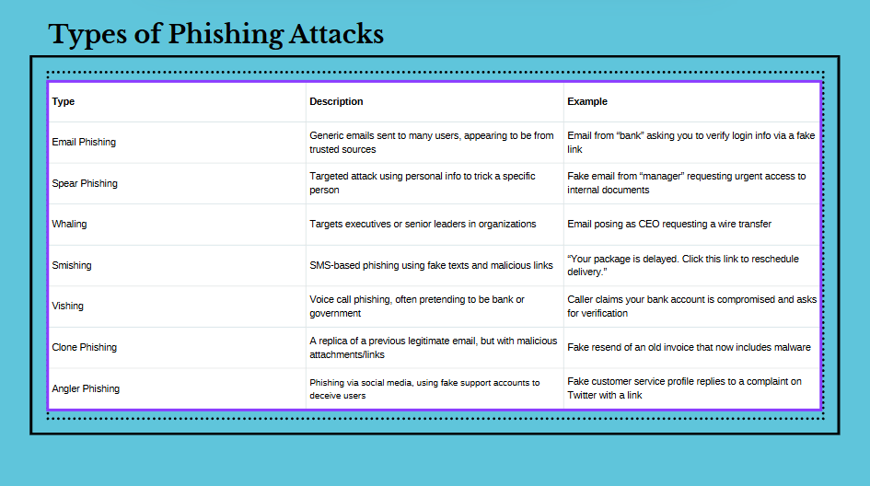

Slide 6
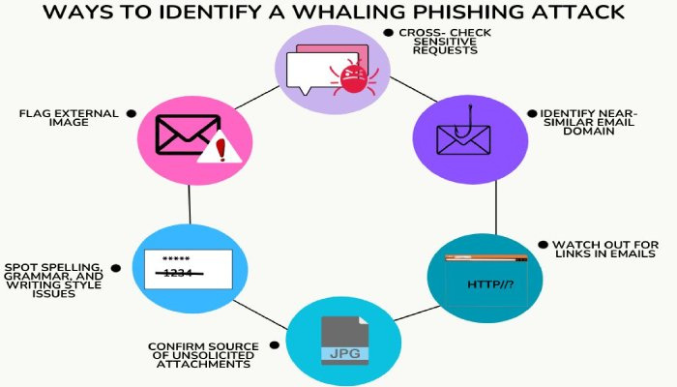

Slide 7
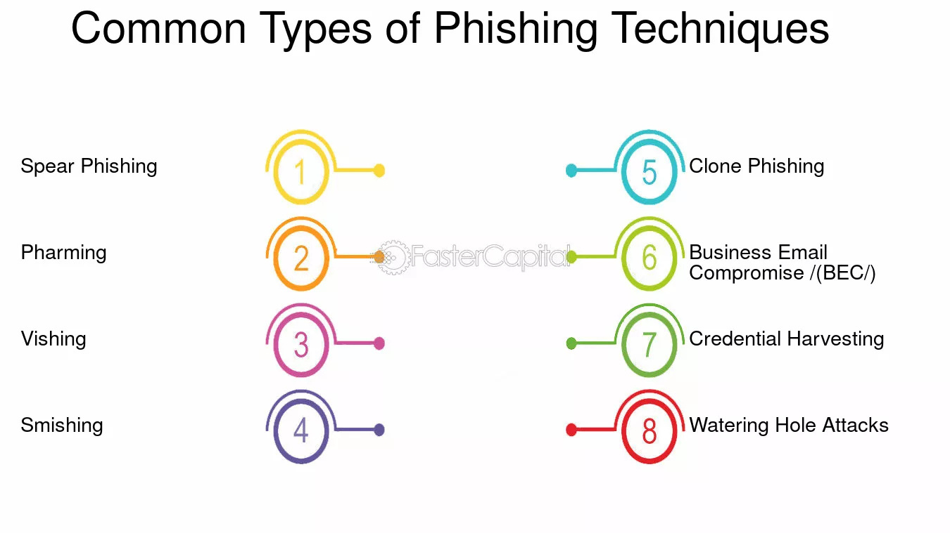

Slide 8
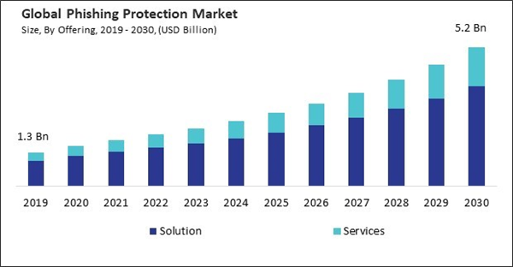

Slide 9
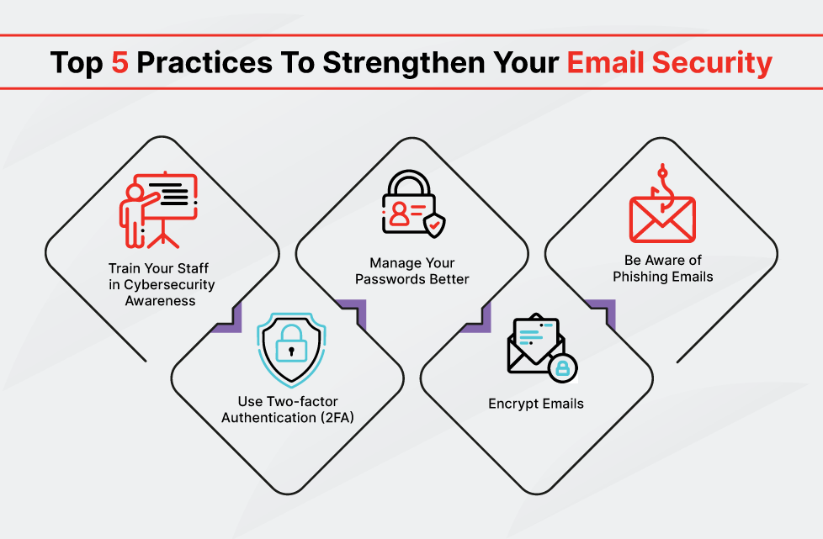

Slide 10

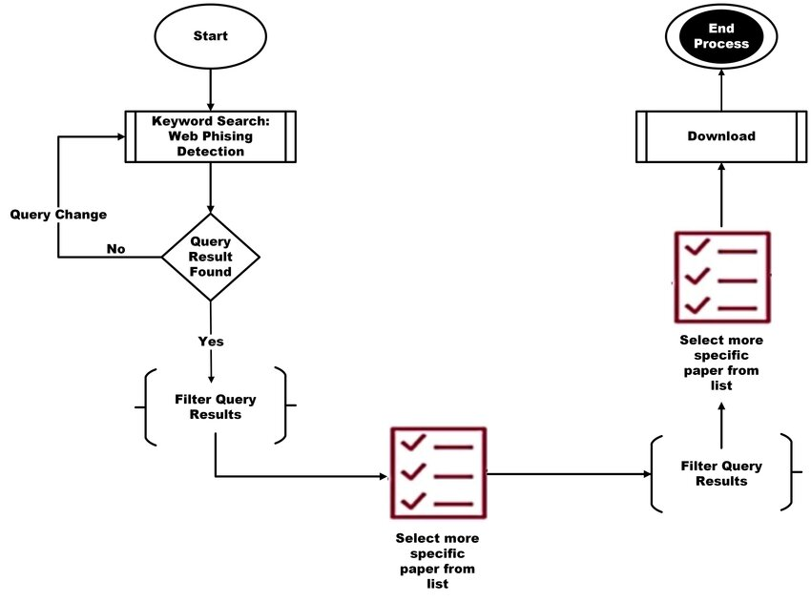
Web Phishing Detection

Slide 11
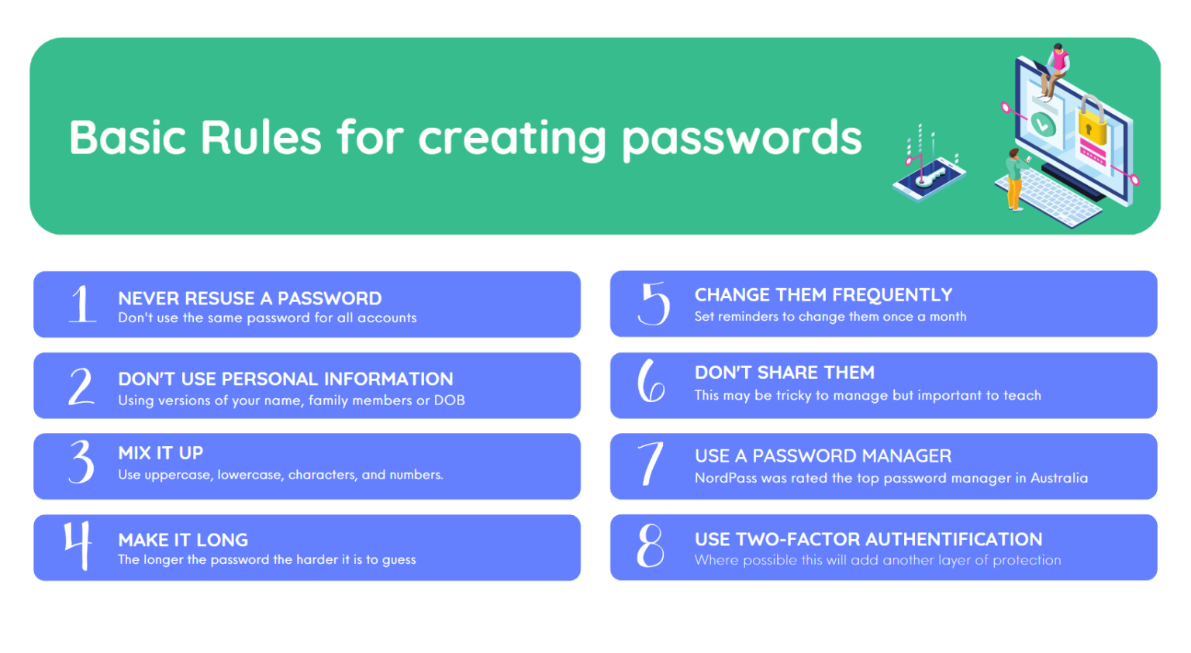

Slide 12
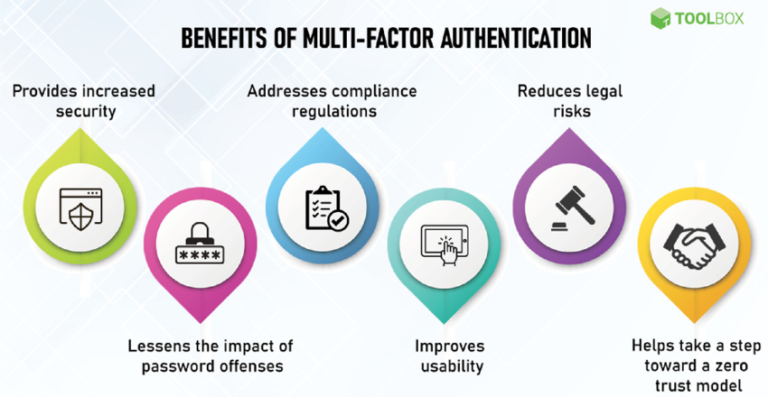

Slide 13
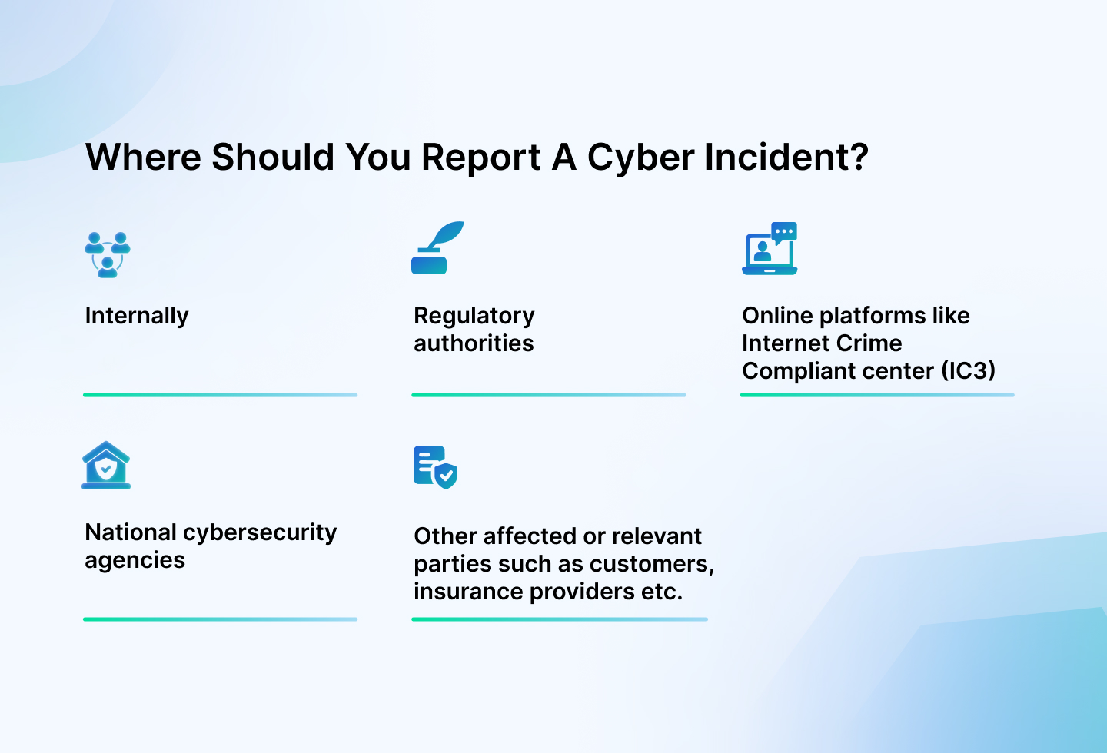

Slide 14







7 Phishing Awareness Training Methods
Open-Source Intelligence (OSINT) for Threat Hunting
Simulated Phishing Campaigns with Technical Feedback
Email Header Analysis Workshops
Advanced Social Engineering Recognition
Data-Driven Training Adaptation
Technical Deep Dives into Malware
Incident Response Simulations

Slide 15
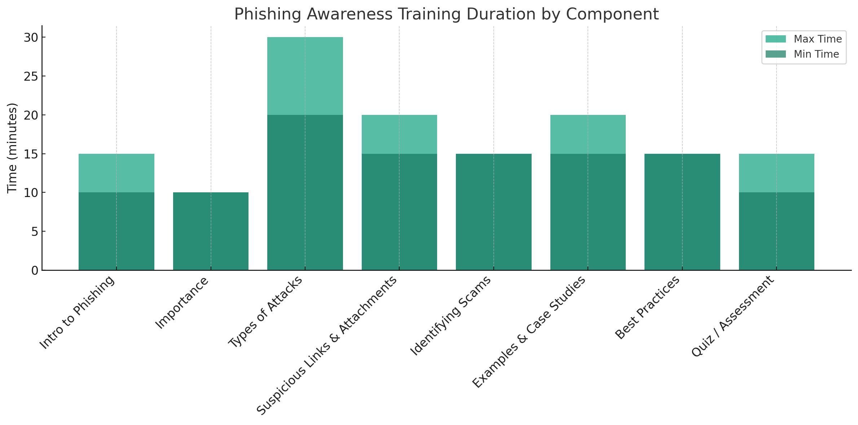

Slide 16
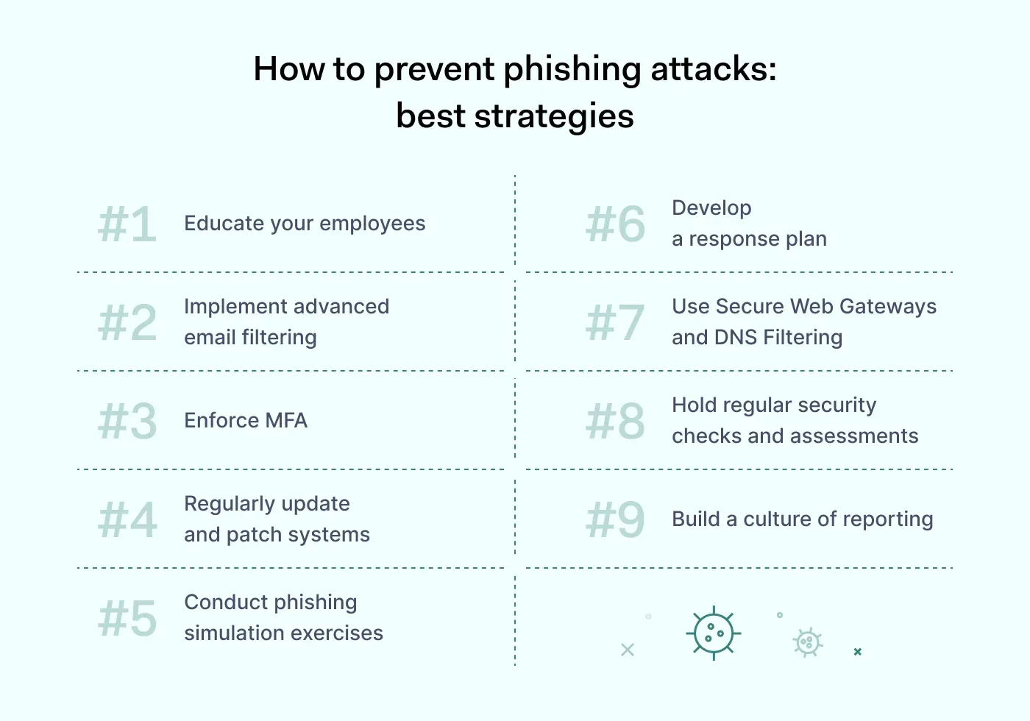

Slide 17
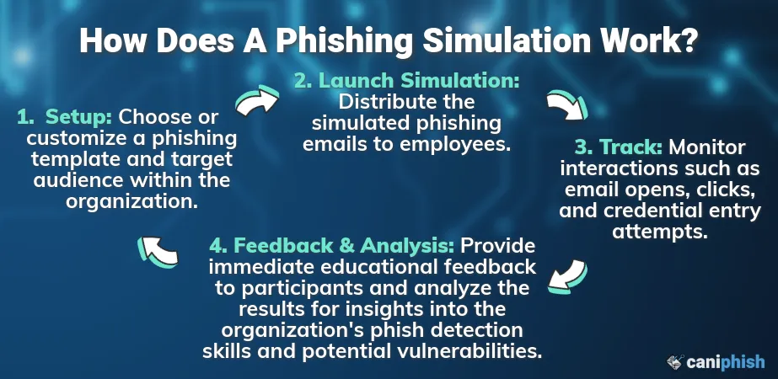

Slide 18
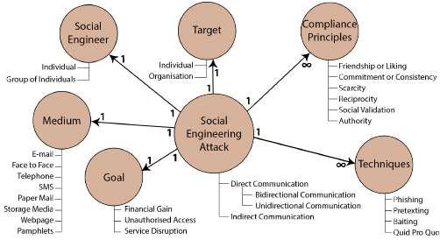

Slide 19
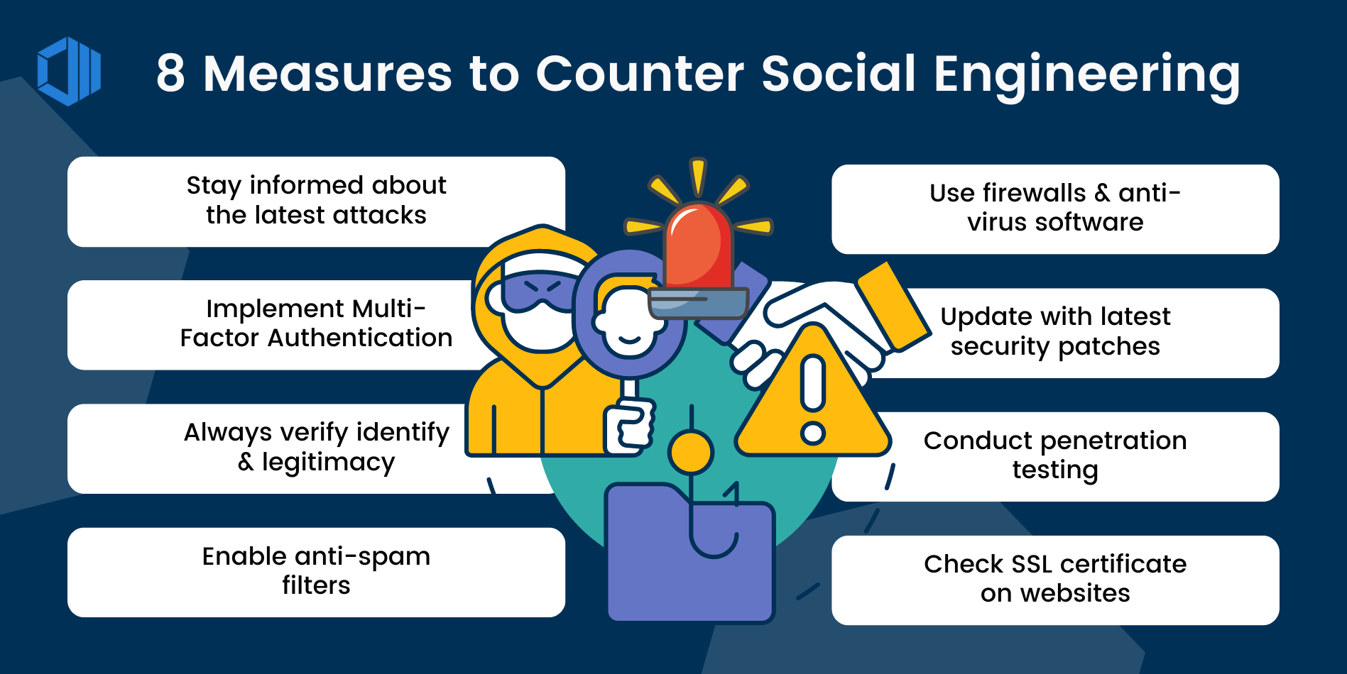

Slide 20
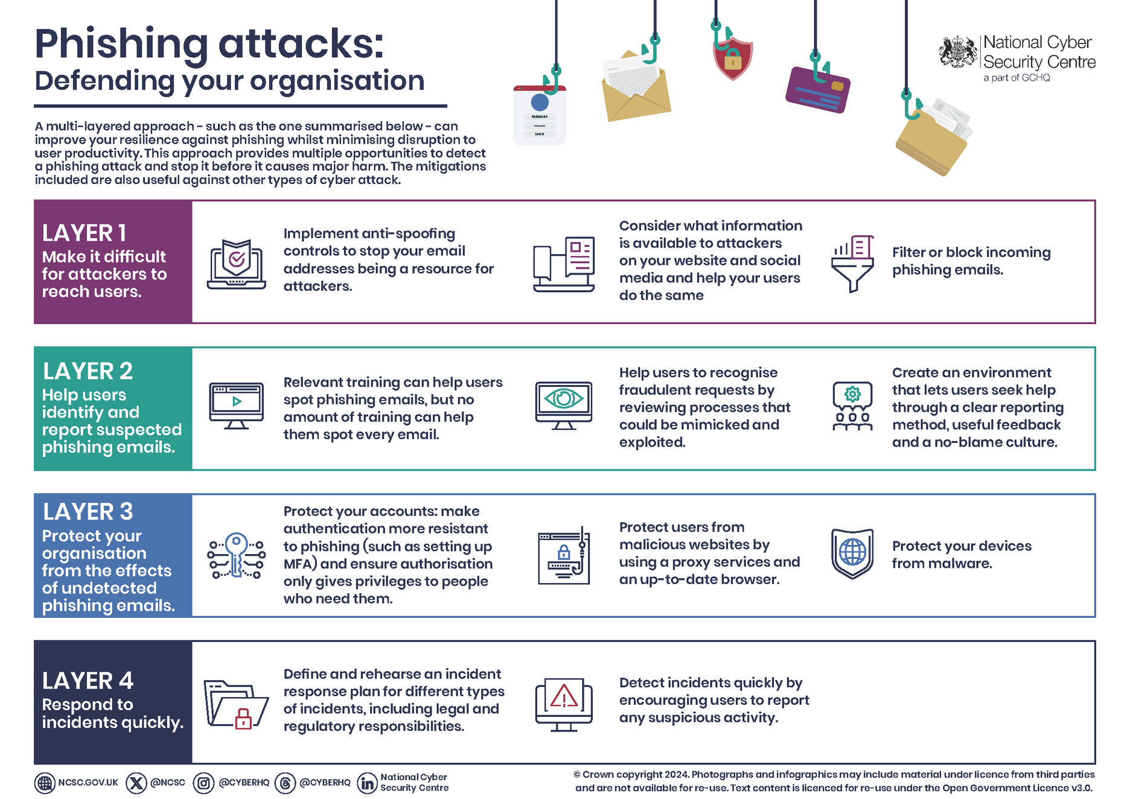

Slide 21
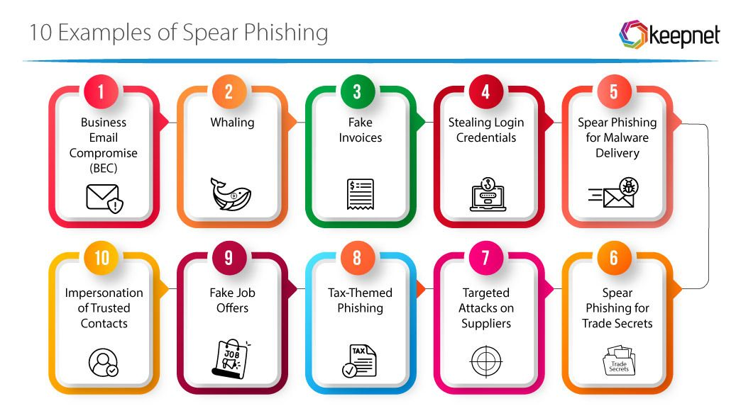

Slide 22
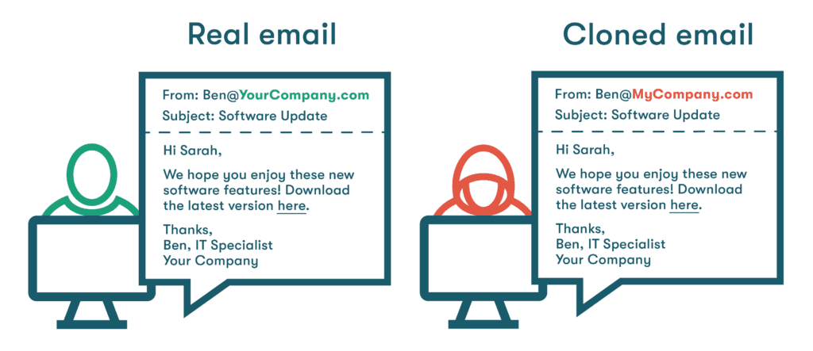

Slide 23
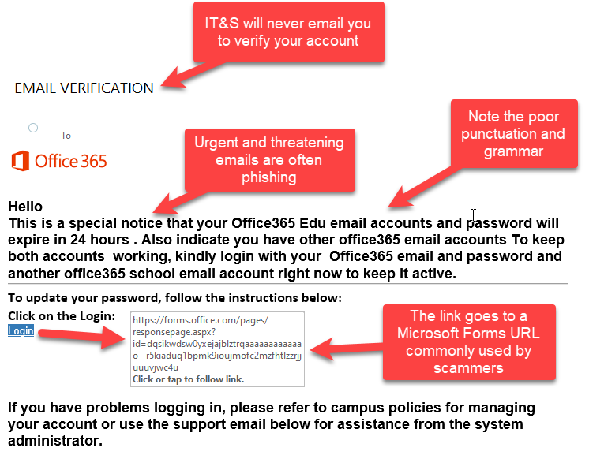

Slide 24

Interactive Quiz (Phishing Awareness) ❓
Question 1
You get an email from your bank asking you to "verify your password immediately." What do you do?
A) Click the link and log in
B) Reply to the email
C) Call the bank directly using the number on your bank card
D) Ignore it
Question 2
Which of the following is a common sign of a phishing email?
A) Personalized greeting with your full name
B) Urgent language like “Your account will be locked!”
C) Sent from your company’s internal domain
D) Signed by your known manager
Question 3
An email contains a link that says www.paypal.com but hovering over it shows www.pavpal.securelogin.ru. What should you do?
A) Click the link to confirm
B) Forward the email to friends
C) Do not click — report it as phishing
D) Reply to verify sender’s identity
Question 4
You receive a call from someone claiming to be your company’s IT department asking for your password. What should you do?
A) Give them your password to avoid delay
B) Ask for their employee ID
C) Refuse and report the call to your supervisor or IT
D) Hang up and ignore
Question 5
Which of the following is the BEST way to protect yourself from phishing?
A) Use the same password for all accounts
B) Enable Two-Factor Authentication (2FA)
C) Only use email during work hours
D) Download all attachments from your boss

Slide 25
Conclusion — Stay Vigilant
⚠️ Phishing attacks are evolving — and getting smarter every day.
✅ Key Takeaways:
Stay alert: Don’t trust emails or messages blindly.
Verify before you act: When in doubt, contact the source directly.
Think before you click: One wrong move can compromise your data.
Protect yourself & your organization: Report suspicious activity.
🔒 Awareness is your best defense.
“Cybersecurity is not just an IT issue — it's everyone's responsibility.”
💡 Tip: Add a soft background image like a lock, shield, or alert icon to visually reinforce the message.

Slide 26

Stay safe and help others stay informed!

Slide 27


